Slide 1
UTHEALTH STOMP OUT STROKE STATION
Take Away Points:
What is a Stroke
Stroke is Common
Causes of Stroke
Strokes are Preventable
Signs of Stroke
Stroke Treatment

Slide 2
What is a Stroke?
Blood is carried to the brain by blood vessels called arteries.
Blood contains oxygen and important nutrients for your brain cells.
Arteries are like pipes carrying blood from the heart to the brain.
A stroke occurs when one of these arteries or “pipes” becomes blocked or ruptures.

Slide 3
What is a Stroke?
A stroke is a brain attack.
A stroke occurs when part of the brain gets no blood flow or low blood flow caused by a clot or rupture of a blood vessel
This causes brain cells to die. The area of dead brain cells is the stroke.
If you think someone is having a stroke, act FAST by calling 911, “Time is Brain.”
During an untreated stroke, many brain cells (an average of 1.9 million) are dying per minute, so getting help for the person FAST is critical.

Slide 4
Stroke is Common!
Stroke is the fifth leading cause of death in the U.S.
Each year nearly 800,000 people experience a new or recurrent stroke.
A stroke happens every 40 seconds.
Nearly 130,000 deaths each year
Every four minutes someone dies from stroke.
Approximately 7 million stroke survivors.
Stroke is a leading cause of adult disability.
Up to 80% of all strokes are preventable through risk factor management.

Slide 5
Two Types of Stroke
Ischemic Stroke= Clot
Most common type of stroke (87% of all strokes). An ischemic stroke happens when an artery in the brain is blocked.
Hemorrhage= Bleeding Stroke
Happens when a blood vessel in the brain bursts and spills blood into or around the brain. High blood pressure and aneurysms can make blood vessels weak enough to burst.

Slide 6
Ischemic Stroke= Clot
Happens when an artery in the brain is blocked.

Slide 7
Ischemic Stroke
Blood Flow in normal and blocked arteries

Slide 8
Ischemic Stroke
Blood Flow in normal and blocked arteries

Slide 9
Ischemic Stroke
Blood Flow in normal and blocked arteries

Slide 10
Hemorrhage= Bleeding Stroke
Happens when a blood vessel in the brain
bursts & spills blood into or around the brain.

Slide 11
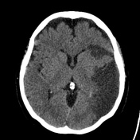
Ischemic Stroke
Brain CT Scans
Hemorrhagic Stroke

Slide 12
Causes of Stroke (Risk Factors)
High Blood Pressure
Diabetes “High Sugars”
High Cholesterol
Tobacco Use
Poor Diet
Lack of Exercise

Slide 13
Recognize stroke and get help
Know the signs of stroke
Act FAST if you think someone is having a stroke
Call 911 if you think someone is having a stroke

Slide 14
Know the signs of stroke using FAST
FACE – Does the FACE look droopy or uneven? Ask the person to smile.
ARM - Does one ARM drift down? Ask the person to raise both arms.
SPEECH - Does the person's SPEECH sound slurred or strange? Ask the person to repeat simple phrase, “The sky is blue.”
TIME - If you see any of these signs “Face droopy, Arm weak or Speech slurred or strange,” then TIME to call 9-1-1. The quicker the person gets to the hospital, the quicker they receive treatment, the better their chances for recovery.
*There are more signs of stroke but above the most common

Slide 15
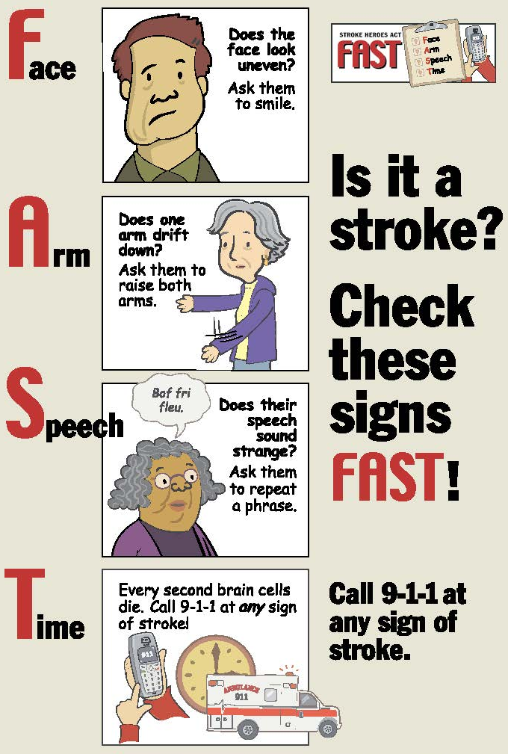
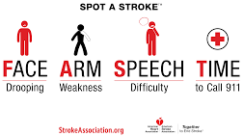

Slide 16
Treatment For Ischemic Stroke (brain clot)
Clot busting medication Alteplase IV r-tPA (tissue plasminogen activator) – “Clot-Busting” drug that dissolves blood clots.
Surgical and endovascular techniques that remove clots

Slide 17
FAST QUIZ
“F” is for _________
“A” is for _________
“S” is for _________
“T” is for ________

Slide 18
“F” Face‐ May appear droopy or uneven when asked to smile.
“A” Arm‐ Check if one arm drifts down more than the other.
“S” Speech‐ May sound slurred or strange.
“T” Time‐ For any of the above stroke signs, Call 911 as soon as possible.

Slide 19
Review Question for Kids
1. True or False
Stroke is a leading cause of death in the country and causes more serious long-term disabilities than any other disease.
2. True or False A stroke can occur in your brain or in your heart.
3. True or False Women are more likely to die from breast cancer than stroke.
4. Which of the following are signs of stroke? (Select all that apply)
a. Sudden confusion, trouble speaking or understanding speech
b. Sudden, severe headache with no known cause
c. Sudden numbness or weakness of the face, arm or leg, especially on one side of
the body
d. Sudden trouble seeing in one or both eyes
e. Sudden trouble walking, dizziness, loss of balance or coordination

Slide 20
Review Question for Kids
5. Stroke symptoms that last only a short time and then disappear are called?
6. A TIA is (choose one from below)
a. Nothing to worry about unless they reoccur.
b. An indication that you could have a major stroke. You should be medically evaluated
immediately.
7. If you believe someone is having a stroke what should you do?
a. Drive them immediately to their doctor's office.
b. Drive them immediately to the nearest emergency room.
c. Call 9-1-1 immediately.
d. Stroke is a medical emergency. Every minute counts when someone is having a stroke.
Immediate treatment can save people's lives and enhance their chances for successful
recovery. Research shows the fastest way to get treatment is to call 9-1-1.
8. Which of the following are risk factors for stroke?
a. High blood pressure
b. Heart disease
c. Smoking
d. High cholesterol
e. Diabetes

