Slide 1
Brain Parts & Function Station
Take Away Points:
The brain is the control and command center of the body.
The skull protects the brain from injury.
The Brain has three main areas: Cerebrum, Cerebellum and Brainstem, each with their own function.
The Cerebrum has a right and left side and is divided into four lobes – Frontal, Parietal, Temporal and Occipital lobes, each with their own function.
Damage to the lobes (Frontal, Parietal, Temporal or Occipital) causes specific problems depending on the lobe function

Slide 2
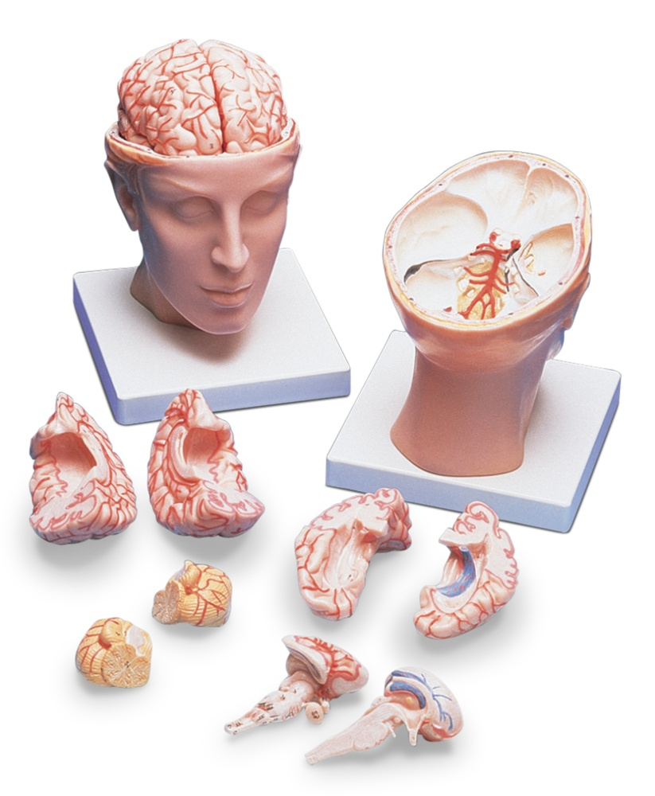
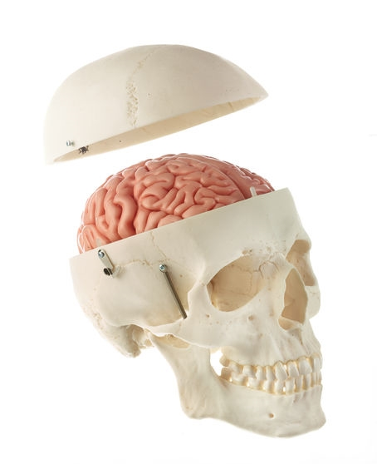
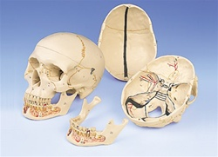
SKULL - protects the brain from injury

Slide 3
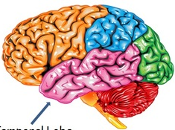
Brain: 3 Main Areas Cerebrum, Cerebellum and Brainstem
CEREBRUM
CEREBELLUM
BRAINSTEM

Slide 4
Brain: 3 Main Areas
Cerebrum
Controls higher brain functions like language, decision-making, emotions, memory and personality.
Has a right and left side, called hemispheres
*Right hemisphere- controls left side of body & houses center for music
& artistic creation.
*Left hemisphere- controls right side of body & houses areas for speech,
reading & math.
Cerebellum
Controls balance, muscle movement and coordination
Brain stem
Controls basic body functions such as heartbeat regulation, breathing, and how awake you are.

Slide 5
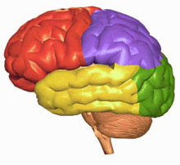
Brain Parts
Cerebrum has 4 lobes
Frontal Lobe
Parietal Lobe
Temporal Lobe
Occipital Lobe

Slide 6
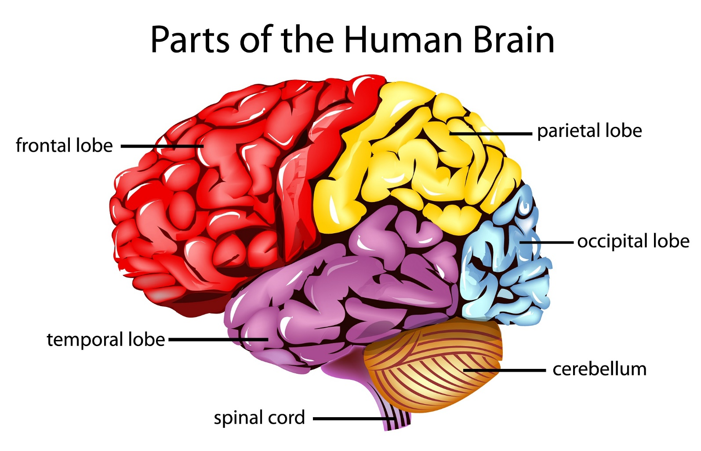
Parts of the Cerebrum

Slide 7
Parts of the Cerebrum

Slide 8
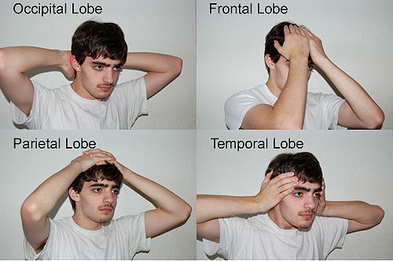
Approximate Locations: Lobes of the Brain
Reference: https://faculty.washington.edu/chudler/lobe.html

Slide 9
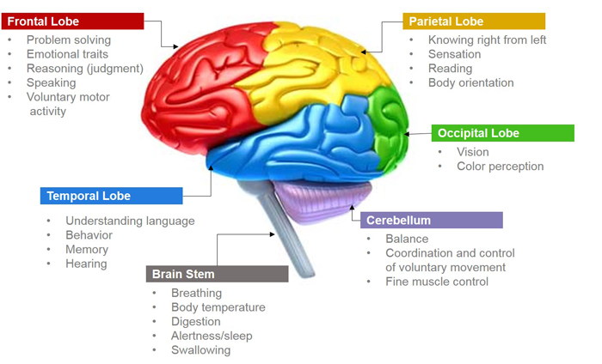

Slide 10
APPLY WHAT YOU LEARNED!
Damage to the labeled parts of the brain will cause what?

Slide 11
Damage to the frontal lobe may cause a change in personality, aggressiveness, memory, depression, apathy and irritability.
Damage to the parietal lobe may cause inability to locate parts of your body and recognize parts of your body.
Damage to the temporal lobe may cause hearing loss, language problems, sensory problems like the inability to recognize a familiar persons face.
Damage to the occipital lobe may cause loss of vision and distorted perception of size, color & shape.

Slide 12
Quiz
What are the three main areas of the brain?
Name the four lobes that make up the cerebrum?
Name at least one function of each lobe?
Damage to the frontal lobe may cause?
Damage to the parietal lobe may cause?
Damage to the temporal lobe may cause?
Damage to the occipital lobe may cause?

